Slide 1

2023 Swine Meat Identification
National Junior Swine Association
Skillathon Resource

Slide 2
Learning Outcomes
Identify and label various retail and wholesale cuts of pork
Explain and understand the importance of the pork industry and meat quality to better meet the demands of the industry and customers
Increase industry awareness and pork cooking safety through knowledge of cooking times, and other relevant cooking measures.

Slide 3
Why is meat identification important?
Meat identification is utilized to better inform producers and bridge the gap to consumer demands
Various wholesale and retail cuts of pork serve different purposes in the industry, varying in type and kind
We as producers want to be as efficient as possible, with pigs that go to market with profitable carcasses and harvest with increased cut-out value

Slide 4
Terms to Know!
Wholesale Cut: is a larger cut of meat that is often distributed at the wholesale level to grocery stores or meat markets
Retail Cut: is a consumer driven cut, that are sized for direct purchase as a meat product, that come from within a wholesale cut.
Meat Quality: is measured by evaluating the muscle and leanness of the meat through standards of color, firmness, wetness, and marbling
Color: is standardized by P (pale), R (red), or D (dark). Most consumers prefer pork that is red or pink in color.
PSE: is low quality pork that is pale, soft, exudative, pigs who are carriers or positive for the stress gene often produce PSE pork
Marbling: is the intramuscular fat within the muscle, that gives pork it’s flavor

Slide 5
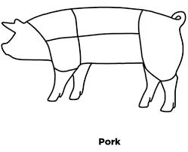
Wholesale Cuts
Within pork, we have five main wholesale cuts:
  1. Boston Butt
  2. Picnic Shoulder
  3. Loin
  4. Side/Belly
  5. Ham
  We also have various cuts that come from ground up other wholesales put together, this includes ground pork, sausage, and cubed meat.
  Variety cuts include other cuts that do not belong to a particular wholesale this includes organ meat, jowl, and hocks.
Boston Butt
Loin
Ham
Picnic Shoulder
Side/Belly

Slide 6
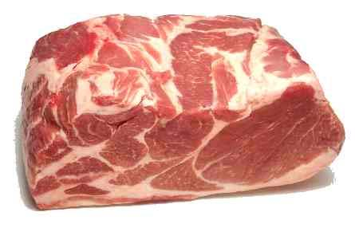
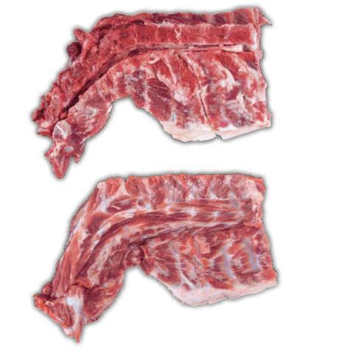
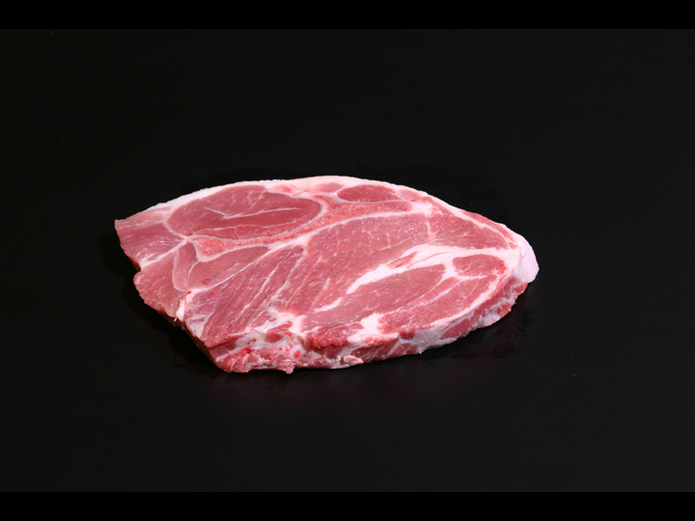
Wholesale: Boston Butt
Retail: Blade Roast
Retail: Neck Bones
Retail: Blade Steak

Slide 7
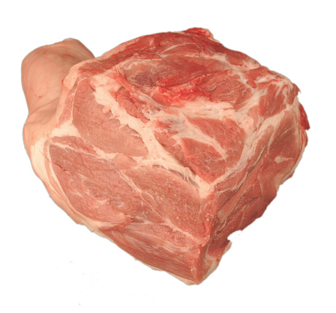
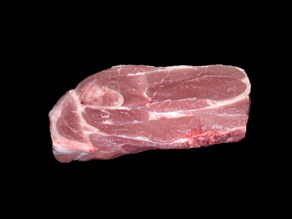
Wholesale: Picnic Shoulder
Retail: Picnic Roast
Retail: Arm Steak

Slide 8
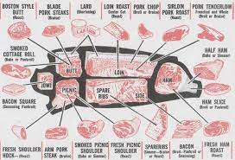
Wholesale: Loin
Retail Cuts
1. Sirloin Chop
2. Sirloin Roast
3. Loin Chop
4. Top Loin Chop Boneless
5. Center Loin Roast
6. Top Loin Roast
7. Tenderloin Roast(Whole)
8. Back Ribs
9. Smoked Canadian Bacon
10. Blade Chop
11. Blade Roast
12. Butterfly Chop

Slide 9
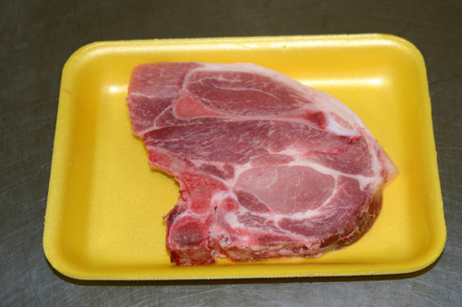
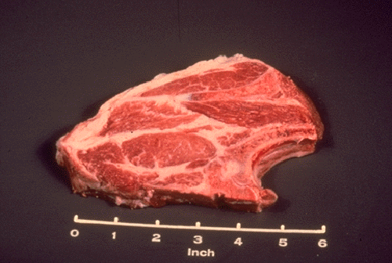
Wholesale: Loin Retail: Loin Blade Chop

Slide 10
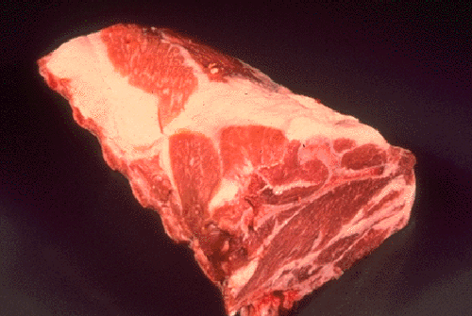
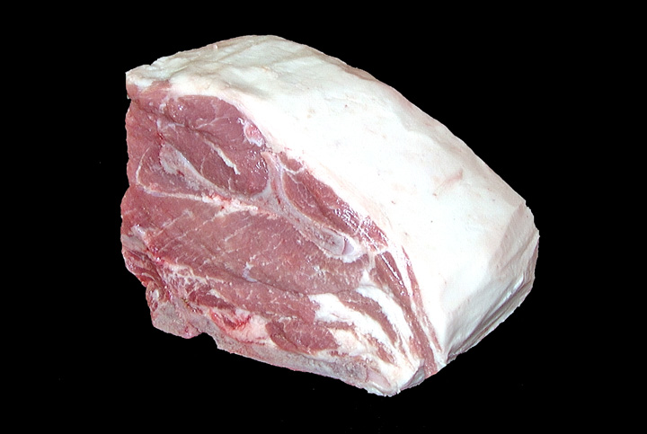
Wholesale: Loin Retail: Loin Blade Roast

Slide 11
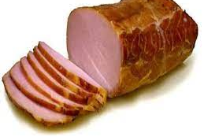
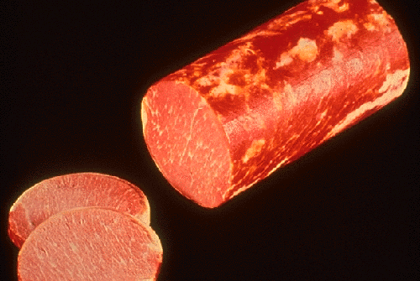
Wholesale: Loin Retail: Smoked Canadian Bacon

Slide 12
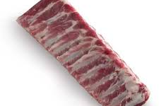
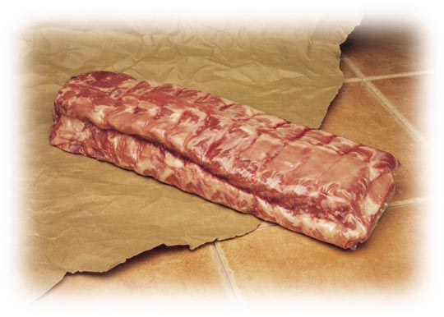
Wholesale: Loin Retail: Backribs

Slide 13
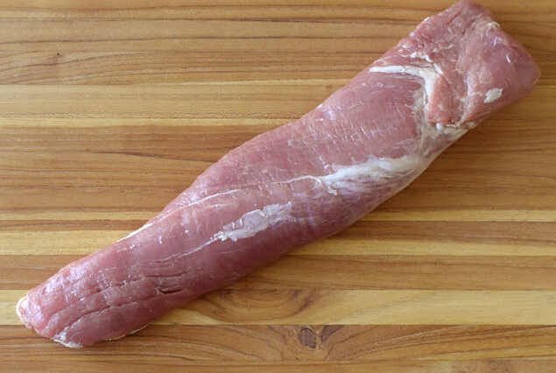
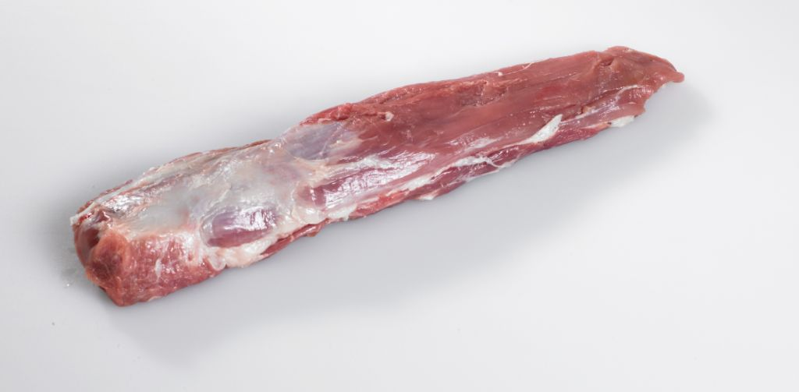
Wholesale: Loin
Retail: Tenderloin Roast (Whole)

Slide 14
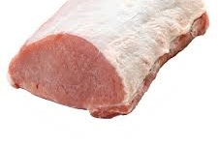
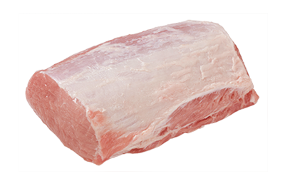
Wholesale: Loin
Retail: Top Loin Roast

Slide 15
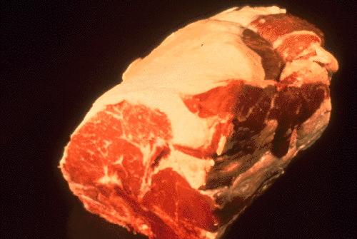
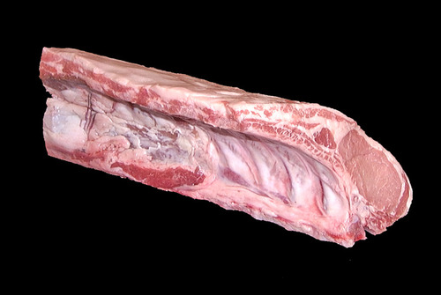
Wholesale: Loin
Retail: Center Loin Roast

Slide 16
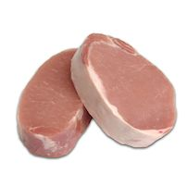
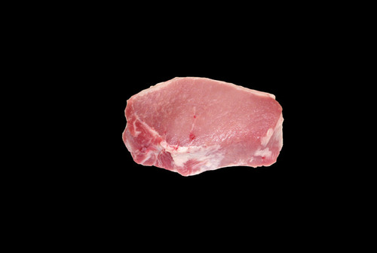
Wholesale: Loin
Retail: Top Loin Chop (Boneless)

Slide 17
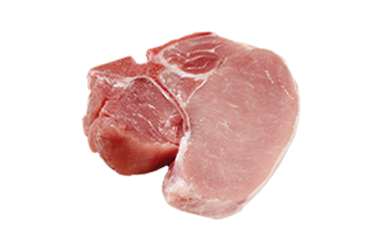
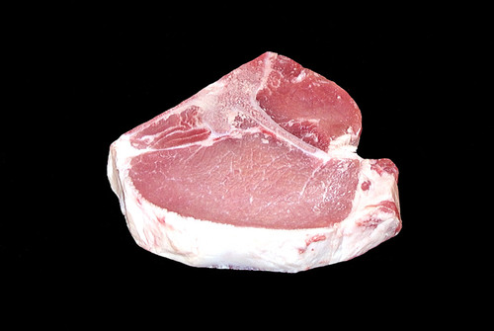
Wholesale: Loin
Retail: Loin Chop

Slide 18
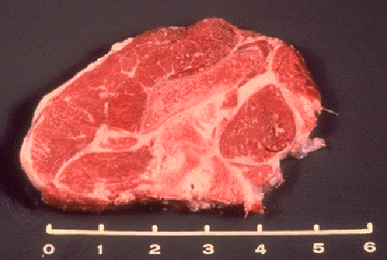
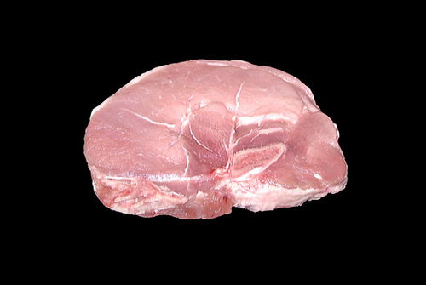
Wholesale: Loin
Retail: Sirloin Chop

Slide 19
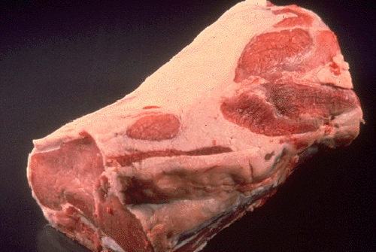
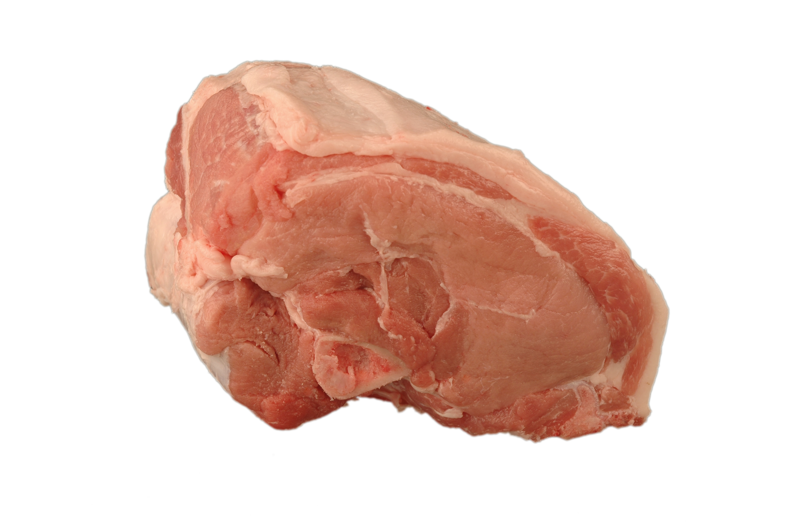
Wholesale: Loin
Retail: Sirloin Roast

Slide 20
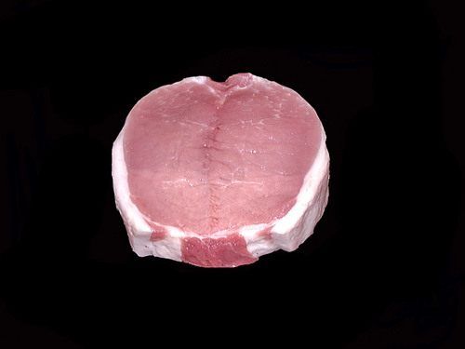
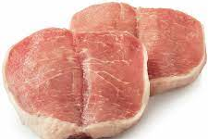
Wholesale: Loin
Retail: Butterfly Chop

Slide 21
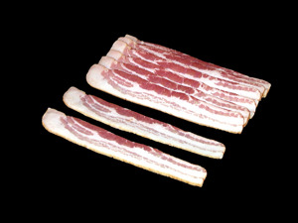
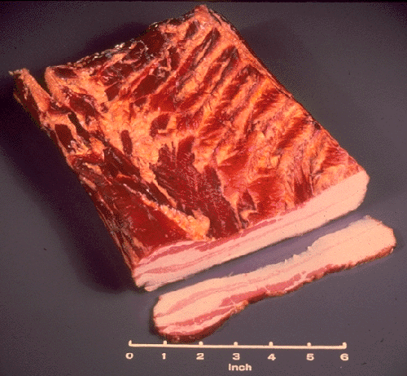
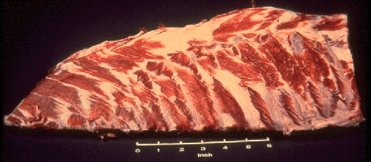
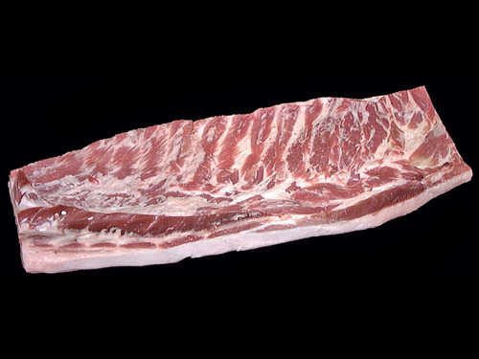
Wholesale: Side/Belly
Retail: Sliced Bacon
Retail: Slab Bacon
Retail: Spareribs
Retail: Fresh Side

Slide 22
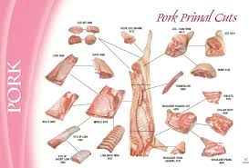
Wholesale: Ham
Retail Cuts
1.Fresh Center Slice
2. Smoked Center Slice
3. Fresh Ham
4. Boneless/Smoked Ham
5. Rump Portion
6. Shank Portion

Slide 23
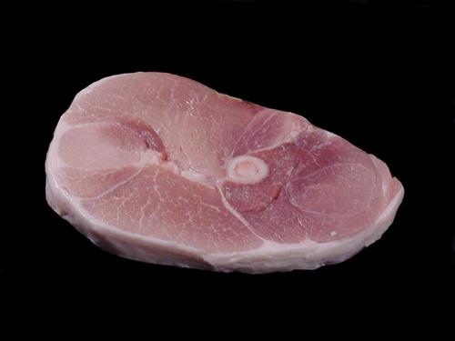
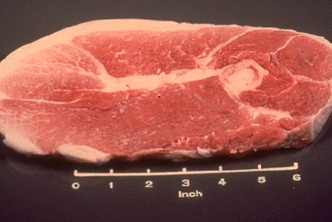
Wholesale: Ham Retail: Center Slice

Slide 24
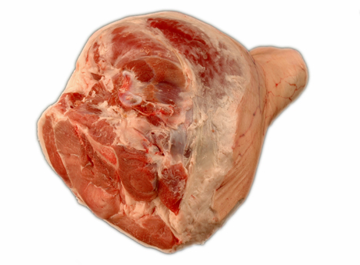
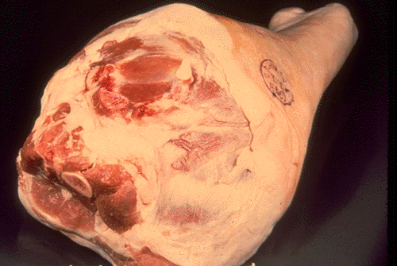
Wholesale: Ham Retail: Fresh Ham

Slide 25
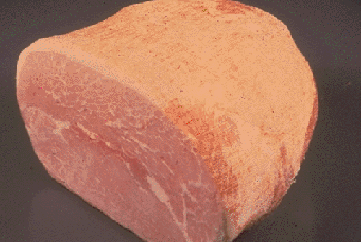
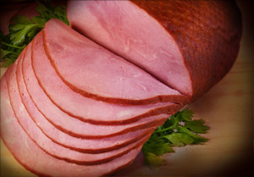
Wholesale: Ham
Retail: Boneless Smoked Ham

Slide 26
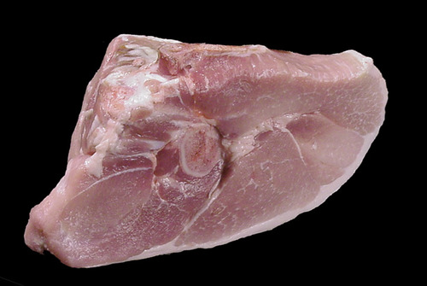
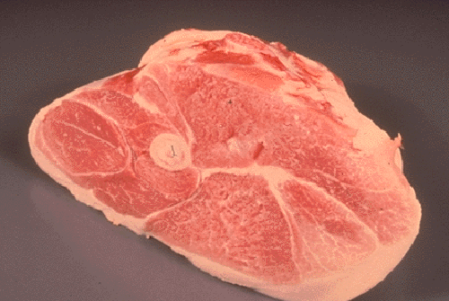
Wholesale: Ham
Retail: Rump Portion

Slide 27
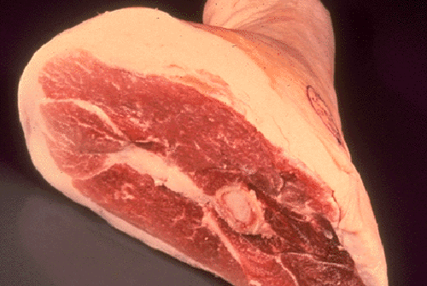
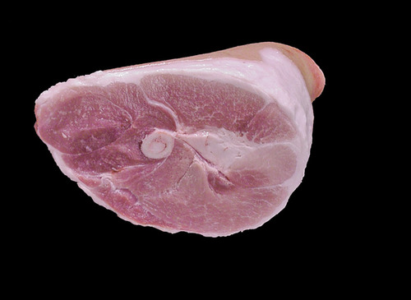
Wholesale: Ham
Retail: Shank Portion

Slide 28
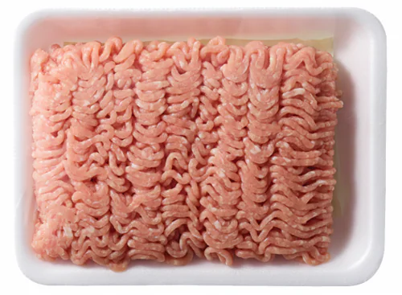
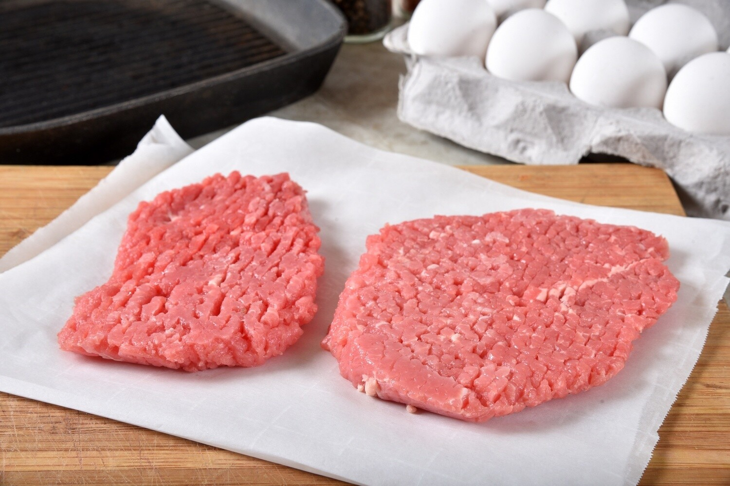
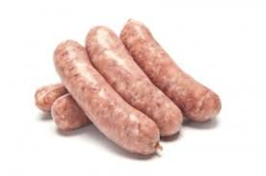
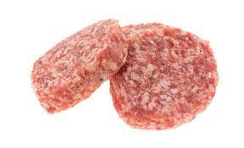
Wholesale: Various
Retail: Ground Pork
Retail: Cubed Steak
Retail: Sausage Links
Retail: Sausage Patties

Slide 29


Wholesale: Variety
Retail: Smoked Jowl
Retail: Smoked Hocks

Slide 30





Wholesale: Variety (Organs)
Retail: Brain
Retail: Tongue
Retail: Kidney
Retail: Liver
Retail: Heart

Slide 31

Example Questions
Take a brief sample quiz to see what you learned and remembered about meat identification!

Slide 32

1. Which of these retail cuts comes from the wholesale Ham?
A.
B.
C.

Slide 33
A.
ANSWER Retail: Center Slice

Slide 34
2. True/ False: Jowl is one of the 5 wholesale cuts of pork?

Slide 35

False- ANSWER
Jowl is a retail cut from the wholesale various!

Slide 36
3. Which of the following retail cuts is the top loin chop?
A.
B.
C.
D.

Slide 37
3. Which of the following retail cuts is the top loin chop?
A.- top loin roast
B.- top loin chop
C.- tenderloin roast
D.- sirloin roast

Slide 38
4. The retail cut fresh shoulder roast comes from which wholesale cut?
Picnic
Boston Butt
Loin
Ham

Slide 39
4. The retail cut shoulder roast comes from which wholesale cut?
Picnic
Boston Butt
Loin
Ham

Slide 40
5. Which wholesale cut of pork is being highlighted?
5.

Slide 41
5. Answer- Picnic Shoulder

Slide 42
Great Job!
You have completed the
“Meat Identification” Skillathon
Resource! Check out our other resources to become a real expert!

